Slide 1
Data Mining Algorithms for Financial Domain
Megan Smith
Sundarkumar Ramsundar

Slide 2
Outline:
Sample of Datasets
Data Exploration (R)
Forecasting (R)
Decomposition (R)
Classification (R)
Clustering (C++)
Prediction KNN (C++) vs ANN

Slide 3
DATE | VALUE
2005-04-01 | 10404.30
2005-04-04 | 10421.14
2005-04-05 | 10458.46
2005-04-06 | 10486.02
2005-04-07 | 10546.32
2005-04-08 | 10461.34
2005-04-11 | 10448.56
2005-04-12 | 10507.97
2005-04-13 | 10403.93
2005-04-14 | 10278.75
2005-04-15 | 10087.51
2005-04-18 | 10071.25
2005-04-19 | 10127.41
2005-04-20 | 10012.36
2005-04-21 | 10218.60
2005-04-22 | 10157.71
2005-04-25 | 10242.47
2005-04-26 | 10151.13
2005-04-27 | 10198.80
2005-04-28 | 10070.37
2005-04-29 | 10192.51
Dow Jones Industrial Average Dataset

Slide 4
Dow Jones Index dataset
QUARTER | STOCK | DATE | OPEN | HIGH | LOW | CLOSE | VOLUME | PERCENT_CHANGE_PRICE | PERCENT_CHANGE_VOLUME_OVER_LAST_WK | PREVIOUS_WEEKS_VOLUME | NEXT_WEEKS_OPEN | NEXT_WEEKS_CLOSE | PERCENT_CHANGE_NEXT_WEEKS_PRICE | DAYS_TO_NEXT_DIVIDENE | PERCENT_RETURN_NEXT_DIVIDEND | ACTION
1 | AA | 1/7/2011 | $15.82 | $16.72 | $15.78 | $16.42 | 239655616 | 3.79267 |  |  | $16.71 | $15.97 | -4.42849 | 26 | 0.182704 | BUY
1 | AA | 1/14/2011 | $16.71 | $16.71 | $15.64 | $15.97 | 242963398 | 0.187852 | 1.380223028 | 239655616 | $16.19 | $15.79 | -2.47066 | 19 | 0.187852 | BUY
1 | AA | 1/21/2011 | $16.19 | $16.38 | $15.60 | $15.79 | 138428495 | -2.47066 | -43.02495926 | 242963398 | $15.87 | $16.13 | 1.63831 | 12 | 0.189994 | SELL
1 | AA | 1/28/2011 | $15.87 | $16.63 | $15.82 | $16.13 | 151379173 | 1.63831 | 9.355500109 | 138428495 | $16.18 | $17.14 | 5.93325 | 5 | 0.185989 | SELL
1 | AA | 2/4/2011 | $16.18 | $17.39 | $16.18 | $17.14 | 154387761 | 5.93325 | 1.987451735 | 151379173 | $17.33 | $17.37 | 0.230814 | 97 | 0.175029 | HOLD

Slide 9
Scatter Plot of Dow Jones Industrial dataset

Slide 10
Scatter Plot Dow Jones Index dataset

Slide 11
Pairs plot of Dow Jones Industrial dataset

Slide 12
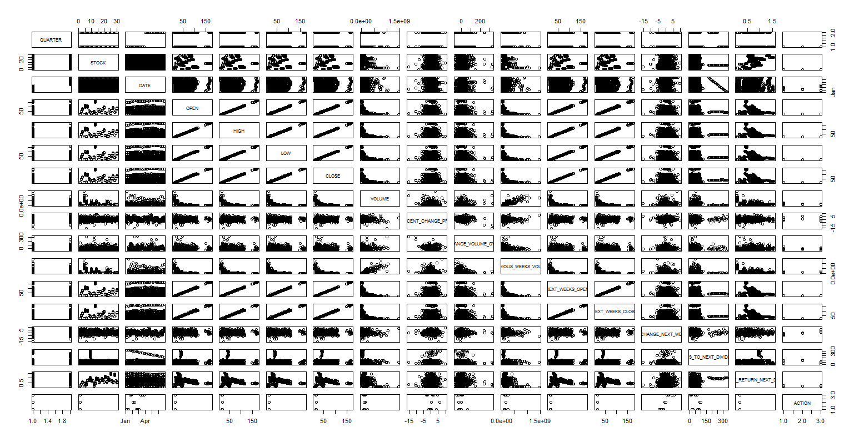

Slide 13
General plot of Dow Jones Industrial dataset

Slide 15
General plot of AA Stock for the 1st Quarter of the Dow Jones Index dataset

Slide 16
General plot of AA Stock for both Quarter of the Dow Jones Index dataset

Slide 18
Seasonal Plot of the Dow Jones Industrial dataset

Slide 20
Classification of the Dow Jones Industrial dataset

Slide 21
Classification of the Dow Jones Index dataset

Slide 23
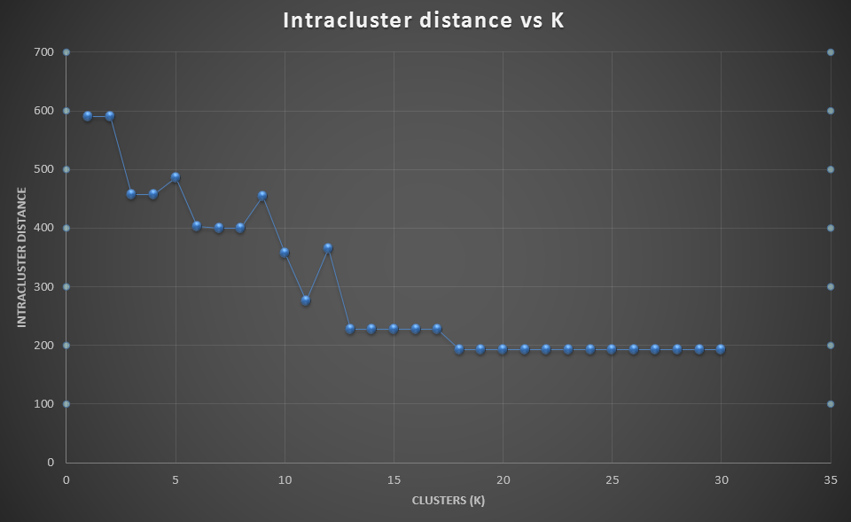
Clustering using K-means (C++)
usd/DZD 0.013467 0.013496 0.013501 0.013533 0.013595 0.013604 0.013585 …. (1001 such values)
usd/ARS 0.24284 0.24255 0.24179 0.24240 0.24202 0.24224 0.24155 0.24127 …… (1001 such values)
Various values of K were compared using Intracluster distance.
K = 11 seems to be a reasonable cluster number.

Slide 24
Prediction using KNN (C++)
Data for prediction
x₀ = 10565.39
x₁ =10470.51
x₂ =10456.02
x₃ =10442.87
x₄ =10485.65
x₅ =10405.70
x₆ =10540.93
x₇ =10503.76
x₈ =10404.30
Tuple | Input (x_{i}) | Input (x_{i+1}) | Input (x_{i+2}) | Output (x_{i+3})
0 | 10565.39 | 10470.51 | 10456.02 | 10442.87
1 | 10470.51 | 10456.02 | 10442.87 | 10485.65
2 | 10456.02 | 10442.87 | 10485.65 | 10405.7
3 | 10442.87 | 10485.65 | 10405.7 | 10540.93
4 | 10485.65 | 10405.7 | 10540.93 | To be predicted
5 | 10405.7 | 10540.93 | 10503.76 | To be predicted

Slide 25
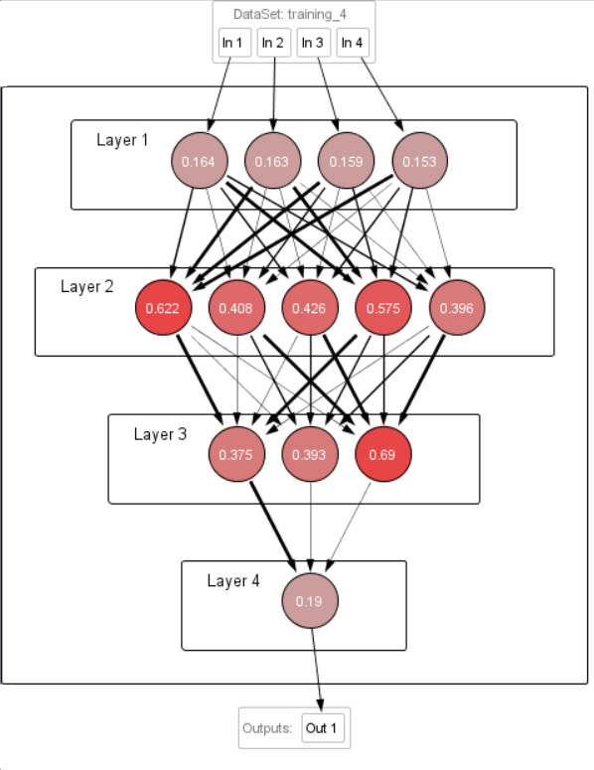
Prediction using ANN
ANN performs better than KNN. The comparison was using NRMSE.

Slide 26
Conclusion
Two pronged approach: R toolset and C++
Using R we performed
Data exploration
Forecast using ARIMA
Decomposition of time series datasets into components like
Seasonal
Observed
Trend
Random
Classification using
Conditional inference trees
Recursive partitioning
Clustering
Using C++ we simulated K-Means algorithm
Comparison for various K using intra cluster distance
Prediction:
Using C++ we simulated KNN algorithm with K-fold validation
Using Neuroph studio simulated ANN
Compared using NRMSE

Slide 27
References:
http://research.stlouisfed.org/fred2/series/DJIA/downloaddata
Jiawei Han, Micheline Kamber, and Jian Pei, “Data Mining: Concepts and Techniques”, 3rd edition
http://archive.ics.uci.edu/ml/datasets/Dow+Jones+Index#
http://www.rdatamining.com/examples/time-series-clustering-classification
http://cran.r-project.org/doc/contrib/Zhao_R_and_data_mining.pdf
file:///C:/Users/megan/Downloads/RDataMining-introduction-slides.pdf

